Slide 1
11 Statistical Inference Concerning Variance
Business Statistics:
Communicating with Numbers, 4e
By Sanjiv Jaggia and Alison Kelly
Copyright 2022 © McGraw Hill LLC. All rights reserved. No reproduction or distribution without the prior written consent of McGraw Hill LLC.

Slide 2
Chapter 11 Learning Objectives (L Os)
L O 11.1 Discuss features of
distribution.
L O 11.2 Make inferences about the population variance.
L O 11.3 Discuss features of the F distribution.
L O 11.4 Make inferences about the ratio of two population variances.

Slide 3
Introductory Case: Assessing the Risk of Mutual Fund Returns
In Chapter 3, we examined annual return data for Vanguard’s Growth fund and Vanguard’s Value fund.
The mean return assesses reward.
The standard deviation assesses risk.
 | Growth | Value
Mean | 15.755 | 12.005
Standard Deviation | 23.7993 | 17.9792
Determine whether the standard deviation of the Growth fund exceeds 20%.
Determine whether the standard deviation of the Value fund differs from 15%.
Determine whether the risk from investing in the Growth fund is significantly greater than the risk from investing in the Value fund.

Slide 4
11.1 Inference Concerning the Population Variance 1
We use the sample mean
as the estimator of the population mean
Inferences about
developed from the sampling distribution of
needed to be (approximately) normally distributed.
We use the sample variance
as an estimator of the population variance
To make inferences regarding
we first need the sampling distribution of
This requires a new distribution.

Slide 5
11.1 Inference Concerning the Population Variance 2
Statistical inferences regarding
are based on the
or chi-square
distribution.
The
distribution is a family of distributions.
Like
depends on df.
Probability distribution for the sum of several independent squared standard normal random variables.
df is the number of squared standard normal random variables in the summation.
is based on the squared differences between the sample values and the
sample mean.

Slide 6
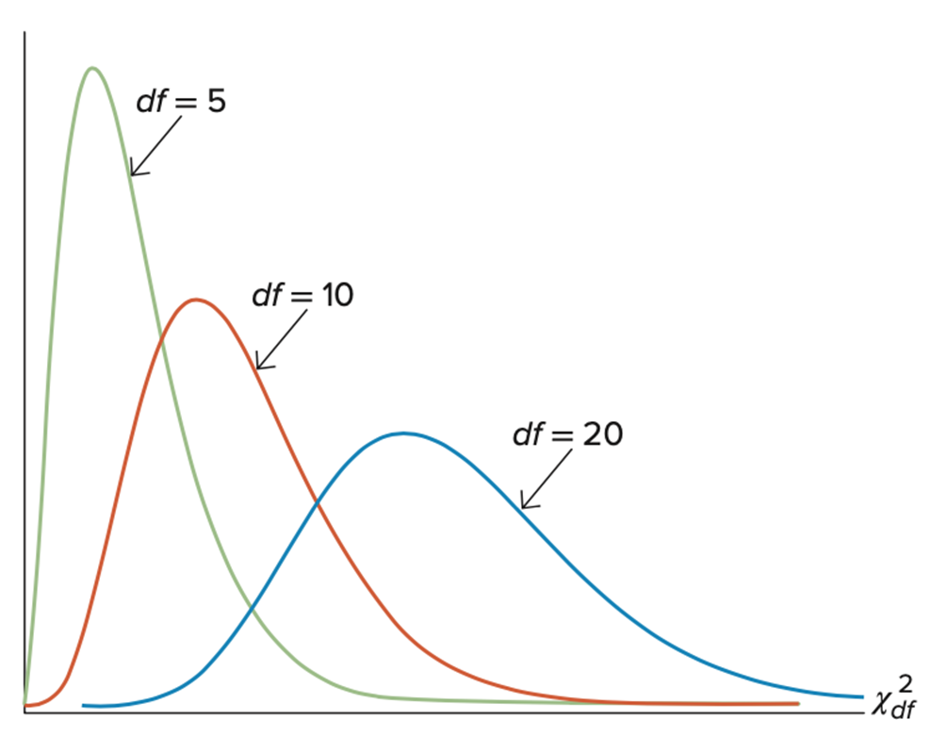
11.1 Inference Concerning the Population Variance 3
ranges from zero to infinity.
is positively skewed, skewness
depends on df.
As the df grow larger,
approaches the normal distribution.

Slide 7
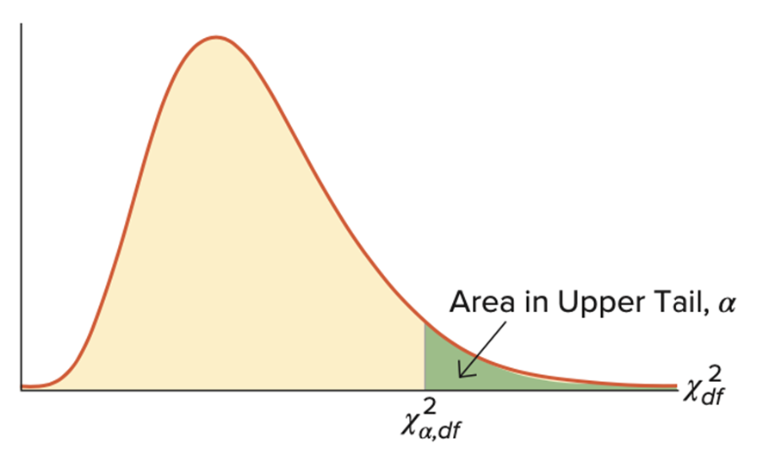
11.1 Inference Concerning the Population Variance 4
Let
represent a value such that the upper (right) tail of the
distribution is
That is,

Slide 8
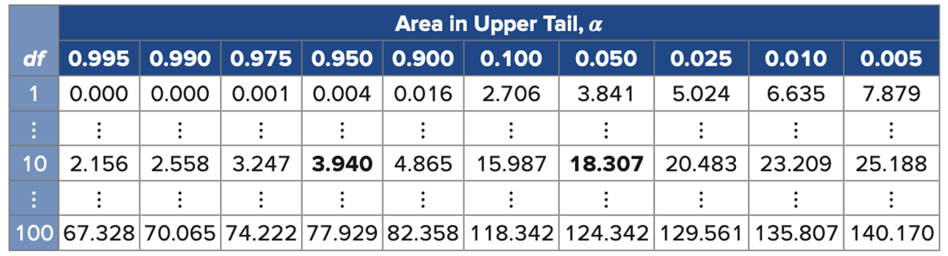
11.1 Inference Concerning the Population Variance 5
Use a table to find
values.
With Excel: CHISQ. INV(cumulprob,df).
With R: qchisq(cumulprob, df, lower.tail=TRUE).
Access the text alternative for slide images.

Slide 9
11.1 Inference Concerning the Population Variance 6
Sometimes we need values in the (left) tail of the distribution.
is not symmetric (unlike z or t_{df}), values in the lower tail are not the
negative of values in the upper tail.
Let
represent a value such that the area to the right is
and the area to the left is

Slide 10
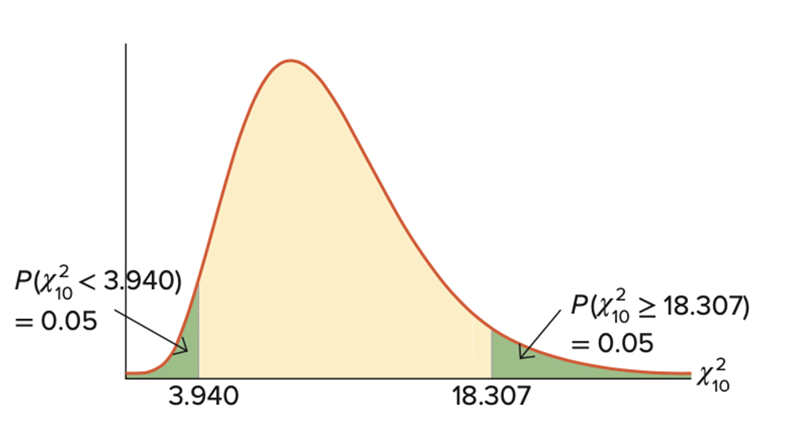
11.1 Inference Concerning the Population Variance 7
Example: find a value such that the area to the left of
is 0.05.
The area to the right is 0.95.
We want

Slide 11
11.1 Inference Concerning the Population Variance 8
Example: find x for which
Table: find df = 5 in the first column, follow this row until we intersect the column 0.025, and find the value 12.833.
Excel: CHISQ.INV(0.975, 5).
R: qchisq(0.975, 5, lower.tail=TRUE).
Example: find x for which
Solve this problem as
Table: we find df = 8 in the first column, follow this row until we intersect the column 0.975, and find 2.180.
Excel: CHISQ.INV(0.025, 8).
R: qchisq(0.025, 8, lower.tail=TRUE).

Slide 12
11.1 Inference Concerning the Population Variance 9
Take a sample of size from a normal population with finite variance.
distribution with df = n − 1.
Since
is not symmetric, the confidence interval does not follow the
form of point estimate ± margin of error.
Start with
Rearrange to get the
confidence interval for
Take the square root to get the
confidence interval for

Slide 13
11.1 Inference Concerning the Population Variance 10
Example: Compute 95% a confidence interval for the population standard deviation for the Growth fund.
Assume that returns are normally distributed.
s = 23.7993, n = 36, df = 35.
Take the square root, to get [19.30,31.04].
With 95% confidence, we report that the standard deviation of the return for the Growth fund is between 19.30% and 31.04%.

Slide 14
11.1 Inference Concerning the Population Variance 11
Let
be a hypothesized value of
The value of the test statistic is
For a two-tailed test, we double the probability that is considered extreme.
Two times the right tail if
Two times the left tail if

Slide 15
11.1 Inference Concerning the Population Variance 12
Example: Dorothy Brennan’s client asks if the standard deviation of returns for the Growth fund exceeds 20%.
This is equivalent to testing if the variance exceeds
Conduct this test at the 5% significance level.
Assume that returns are normally distributed.

Slide 16
11.1 Inference Concerning the Population Variance 13
Example, continued.
We wish to determine whether the variance is greater than 400(%).
s = 23.7993, n = 36, df = 35.

Slide 17
11.1 Inference Concerning the Population Variance 14
Example, continued.
The p-value is
or between 0.05
and 0.10 using the table.
Do not reject the null hypothesis.
At the 5% significance level, the variance of the Growth fund is not greater
than
Equivalently, the standard deviation does not exceed 20%, implying that the risk associated with this investment is not more than what the client wants to accept.

Slide 18
11.1 Inference Concerning the Population Variance 15
Example: Dorothy Brennan’s client from the introductory case also wonders if the standard deviation of returns for the Value fund differs from 15%.
This is equivalent to testing if the variance differs from
Conduct this test at the 5% significance level.
Assume that returns are normally distributed.

Slide 19
11.1 Inference Concerning the Population Variance 16
Example, continued.
This is an example of a two-tailed test.
n = 36, df = 35.
With Excel,
Use VAR.S to find the variance: s = 23.7993,
Compute the test statistic:
Use CHISQ.DIST.RT to find the p-value: 2*CHISQ. DIST.RT(50.284, 35)=0.091

Slide 20
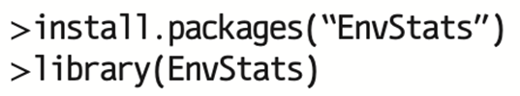
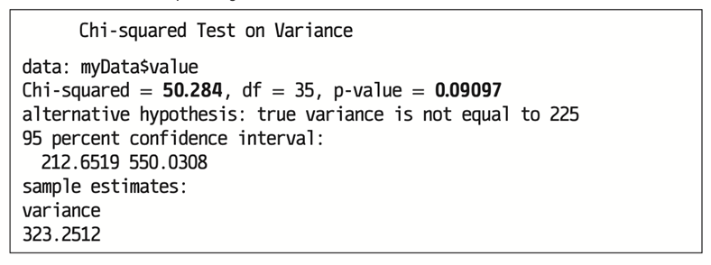
11.1 Inference Concerning the Population Variance 17
Example, continued with R.
Do not reject the null hypothesis.
At the 5% level, we cannot conclude that the risk, measured by the variance
of the return, differs from
Access the text alternative for slide images.

Slide 21
11.2 Inference Concerning the Ratio of Two Population Variances 1
We compare two population variances,
through the ratio
If
The ratio of the sample variances
is an estimator of
The sample variances are computed from independent random samples, drawn from two normally distributed populations.
We need to first understand the sampling distribution of

Slide 22
11.2 Inference Concerning the Ratio of Two Population Variances 2
The sampling distribution of
the F distribution.
The F distribution is characterized by a family of distributions.
Like t_{df} and
F depends on two degrees of freedom.
df₁ is the numerator degrees of freedom.
df₂ is the denominator degrees of freedom.
Denoted
is the probability distribution of the ratio of two independent chi-squared
variables divided by their degrees of freedom.

Slide 23
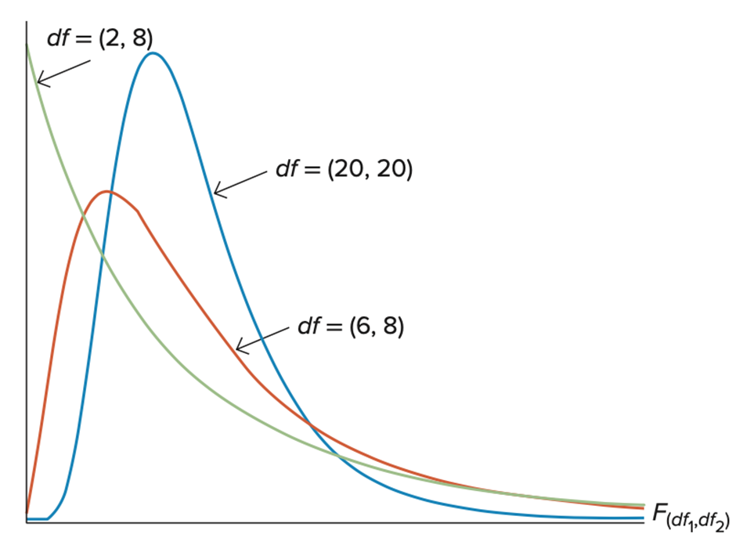
11.2 Inference Concerning the Ratio of Two Population Variances 3
ranges from zero to infinity.
is positively skewed,
skewness depends on df₁ and df₂.
As df₁ and df₂ grow larger,
approaches the normal distribution.
Access the text alternative for slide images.

Slide 24
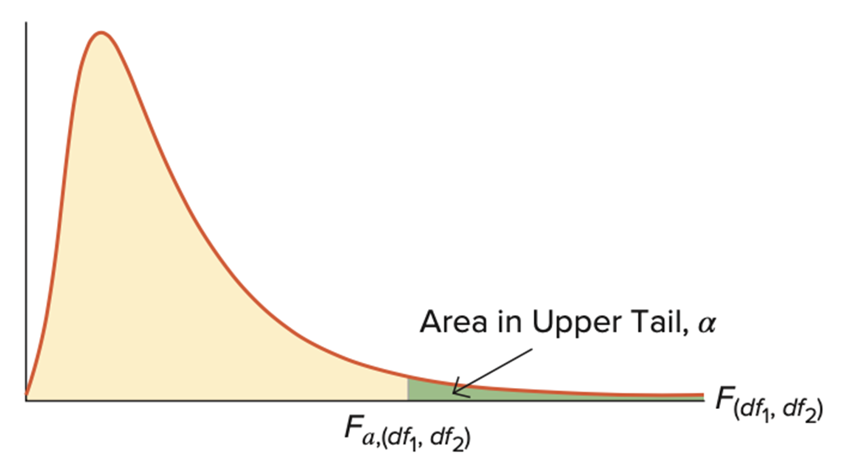
11.2 Inference Concerning the Ratio of Two Population Variances 4
Let
represent a value such that the upper (right) tail of the
distribution is
That is,

Slide 25
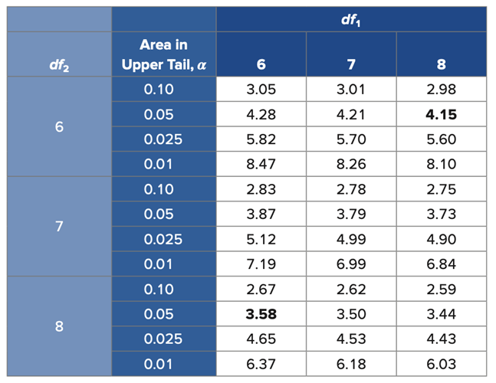
11.2 Inference Concerning the Ratio of Two Population Variances 5
Use a table to find
values.
With Excel: F. INV(cumulprob, df1,df2).
With R: qf(cumulprob, df1, df2, lower.tail=TRUE).
Access the text alternative for slide images.

Slide 26
11.2 Inference Concerning the Ratio of Two Population Variances 6
Sometimes we need to derive values such that the area to the left of a
given value is equal to
Let
denote a value such that the area to the right is
and the area to the left is
To find
use the following rule:
The rule reverses the order of the numerator and the denominator degrees of freedom.

Slide 27
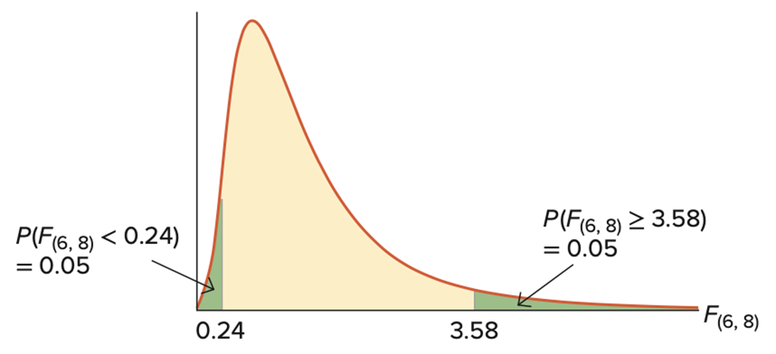
11.2 Inference Concerning the Ratio of Two Population Variances 7
Example: Find a value such that the area to the left of
is 0.05.
The area to the right is 0.95.
We want

Slide 28
11.2 Inference Concerning the Ratio of Two Population Variances 8
Example: Find x for which
Table: Follow the column corresponding to 7 until it intersects with the row corresponding to 10 and for 0.025; we find the value 3.95.
Excel: F.INV(0.975,7,10).
R: qf(0.975, 7, 10, lower.tail=TRUE).
Example: Find x for which
Table:
Excel: F.INV(0.05,7,10).
R: qf(0.05, 7, 10, lower.tail=TRUE).

Slide 29
11.2 Inference Concerning the Ratio of Two Population Variances 9
Suppose you have independent samples of size n₁ and n₂ are drawn from normal populations with equal variances.
distribution with df₁ = n₁ − 1 and df₂ = n₂ − 1 .
A
confidence interval for the ratio of the population variances
is computed as
Note df₁ = n₁ − 1 and df₂ = n₂ − 1.

Slide 30
11.2 Inference Concerning the Ratio of Two Population Variances 10
Example: Students of two sections of a statistics course took a common final examination.
A professor examines the variability in scores between the two sections.
Random samples of n₁ = 11 and n₁₆ = 16 yield sample variances of
Construct the 95% confidence interval for the ratio of the population variances.
Assume that the samples are independently drawn from two normally distributed populations.

Slide 31
11.2 Inference Concerning the Ratio of Two Population Variances 11
Example, continued.
With 95% confidence we can conclude that the variance of scores in the first section is between 13% and 140% of the variance of scores in the second section.

Slide 32
11.2 Inference Concerning the Ratio of Two Population Variances 12
Compare two population variances
with the competing hypotheses.
Right tail: tests
Left tail: tests
The test statistic is
df₁ = n₁ − 1 and df₂ = n₂ − 1.

Slide 33
11.2 Inference Concerning the Ratio of Two Population Variances 13
It is preferable to place the larger sample variance in the numerator of the
The resulting value allows us to focus only on the upper (right) tail of the distribution.
The degrees of freedom is adjusted accordingly.

Slide 34
11.2 Inference Concerning the Ratio of Two Population Variances 14
Example: Dorothy Brennan’s client wonders if the Growth fund is riskier than the Value fund.
Assume that returns are normally distributed to implement the test at the 5% significance level.
s₁ = 23.7993, n₁ = 36, s₂ = 17.9792, n₂ = 36.
Let
denote the population variances of the Growth and the
Value funds.
since s₁ > s₂ the specification is appropriate.

Slide 35

11.2 Inference Concerning the Ratio of Two Population Variances 15
Example, continued.
The p-value is
With Excel: use VAR.S to compute the variance, and F.DIST.RT(1.7522,35,35) to compute the p-value.
With R:
Access the text alternative for slide images.

Slide 36
11.2 Inference Concerning the Ratio of Two Population Variances 16
Example, continued with Excel.
Use VAR.S to compute the variances.
Compute
The p-value is
Use F.DIST.RT(1.7522, 35, 35) to compute the p-value.

Slide 37
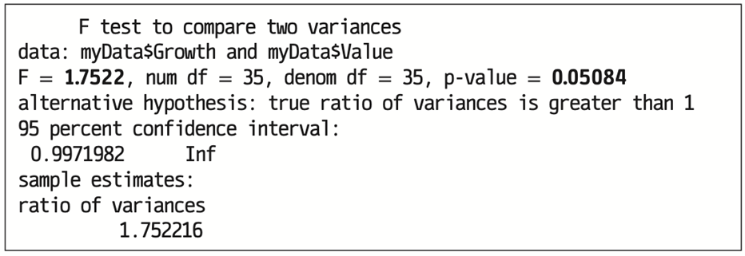
11.2 Inference Concerning the Ratio of Two Population Variances 17
Example, continued with R.
The p-value is 0.051.
Do not reject the null hypothesis.
At the 5% significance level, we cannot conclude that the Growth fund is riskier than the Value fund.
Access the text alternative for slide images.

Slide 38
End of Main Content
Copyright 2022 © McGraw Hill LLC. All rights reserved. No reproduction or distribution without the prior written consent of McGraw Hill LLC.

Slide 39
Accessibility Content: Text Alternatives for Images

Slide 40
11.1 Inference Concerning the Population Variance 5 – Text Alternative
Return to parent-slide containing images.
A table titled, Area in Upper Tail, alpha. The Table has 3 Rows and 11 columns. The columns have the following headings from left to right. df, 0.995, 0.990, 0.975, 0.950, 0.900, 0.100, 0.050, 0.250, 0.010, 0.005, . The Row entries are as follows.
Row 1. df, 1. 0.995, 0.000. 0.990, 0.000. 0.975, 0.001. 0.950, 0.004. 0.900, 0.016. 0.100, 2.706. 0.050, 3.841. 0.250, 5.024. 0.010, 6.635. 0.005, 7.879.
Row 2. df, 10. 0.995, 2.156. 0.990, 2.558. 0.975, 3.247. 0.950, 3.940. 0.900, 4.865. 0.100, 15.987. 0.050, 18.309. 0.250, 20.483. 0.010, 23.209. 0.005, 25.188.
Row 3. df, 100. 0.995, 67.328. 0.990, 70.065. 0.975, 74.222. 0.950, 77.929. 0.900, 82.358. 0.100, 118.342. 0.050, 124.342. 0.250, 129.561. 0.010, 135.807. 0.005, 140.170.
Return to parent-slide containing images.

Slide 41
11.1 Inference Concerning the Population Variance 17 – Text Alternative
Return to parent-slide containing images.
For first image, program code. In the code, the words in the variable names are merged.Line 1. > install.packages, left parenthesis, open quotes, Envstats, close quotes, right parenthesis. Line 2. > library, left parenthesis, Envstats, right parenthesis.
For second image, program code. In the code, the words in the variable names are merged. Line 1. > varTest, left parenthesis, myDatadollarvalue, comma, alternative = open quotes, two.sided, close quotes, comma, sigma.squared = 225, right parenthesis.
For third image, R’s output using var Test function to find the p-value when table summary is provided instead of raw data. The value of Chi-Squared is 50.284, d f is 35, and p-value is 0.09097. Alternative hypothesis shows true variance is not equal to 225. 95 percent confidence interval is 212.6519 and 550.0308. The sample estimates of variance are 323.2512.
Return to parent-slide containing images.

Slide 42
11.2 Inference Concerning the Ratio of Two Population Variances 3 – Text Alternative
Return to parent-slide containing images.
The steepest decline has df = (2, 8), the next curve (which is slightly more normal) is df (6, 8). The most normal curve has df = (20, 20).
Return to parent-slide containing images.

Slide 43
11.2 Inference Concerning the Ratio of Two Population Variances 5 – Text Alternative
Return to parent-slide containing images.
A Table has 12 Rows and 5 columns. The columns have the following headings from left to right. df_2, Area in Upper Tail, alpha, 6, 7, 8, . The Row entries are as follows.
Row 1. df_2, 6. Area in Upper Tail, alpha, 0.10. 6, 3.05. 7, 3.01. 8, 2.98.
Row 2. df_2, Area in Upper Tail, alpha, 0.05. 6, 4.28. 7, 4.21. 8, 4.15.
Row 3. df_2, Area in Upper Tail, alpha, 0.025. 6, 5.28. 7, 5.70. 8, 5.60.
Row 4. df_2, Area in Upper Tail, alpha, 0.01. 6, 8.47. 7, 8.26. 8, 8.10.
Row 5. df_2, 7. Area in Upper Tail, alpha, 0.10. 6, 2.83. 7, 2.78. 8, 2.75.
Row 6. df_2, Area in Upper Tail, alpha, 0.05. 6, 3.87. 7, 3.79. 8, 3.73.
Row 7. df_2, Area in Upper Tail, alpha, 0.025. 6, 5.12. 7, 4.99. 8, 4.90.
Row 8. df_2, Area in Upper Tail, alpha, 0.01. 6, 7.19. 7, 6.99. 8, 6.84.
Row 9. df_2, 8. Area in Upper Tail, alpha, 0.10. 6, 2.67. 7, 2.62. 8, 2.59.
Row 10. df_2, Area in Upper Tail, alpha, 0.05. 6, 3.58. 7, 3.50. 8, 3.44.
Row 11. df_2, Area in Upper Tail, alpha, 0.025. 6, 4.65. 7, 4.53. 8, 4.43.
Row 12. df_2, Area in Upper Tail, alpha, 0.01. 6, 6.37. 7, 6.18. 8, 6.03.
Return to parent-slide containing images.

Slide 44
11.2 Inference Concerning the Ratio of Two Population Variances 15 – Text Alternative
Return to parent-slide containing images.
Program code. In the code, the words in the variable names are merged. Line 1. > Var.test, left parenthesis, myDatadollarGrowth, comma, myDatadollarvalue, comma, ratio = 1, comma. Line 2. indended once, alternative = open quotes, greater, close quotes, close parenthesis.
Return to parent-slide containing images.

Slide 45
11.2 Inference Concerning the Ratio of Two Population Variances 17 – Text Alternative
Return to parent-slide containing images.
For first image, program code. In the code, the words in the variable names are merged. Line 1. > Var.test, left parenthesis, myDatadollarGrowth, comma, myDatadollarvalue, comma, ratio = 1, comma. Line 2. indended once, alternative = open quotes, greater, close quotes, close parenthesis.
For second image, R’s output using var Test function to find the p-value when table summary is provided instead of raw data. The value of F is 1.7522, num d f is 35, denom d f is 35, and p-value is 0.05084. Alternative hypothesis shows true ratio of variance is greater than 1. 95 percent confidence interval is 0.9971982. The sample estimates of ratio of variances is 1.752216.
Return to parent-slide containing images.

